Slide 1
Document Object Model (DOM)
David Tarvin, AIM Code School

Slide 2
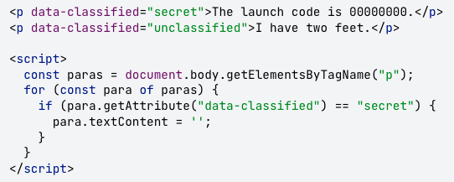
textContent
The textContent property can be used to get all the text in the node
Setting it to an empty string empties the contents of the node

Slide 3
What is the Document Object Model (DOM)?
It is a representation of the HTML that makes up the web page
When a web page is loaded, the following happens:
The JavaScript engine analyzes the HTML
The JavaScript converts the HTML into an internal format that the runtime environment can actually run.
This internal format is called the DOM tree.
The act of analyzing and converting is called parsing the document.
The browser then builds up a model of the document’s structure
The browser then uses the model to draw the page on the screen
The model of the document is a live data structure that you can read from and change
When it is modified, the page on the screen is updated to reflect the changes

Slide 4
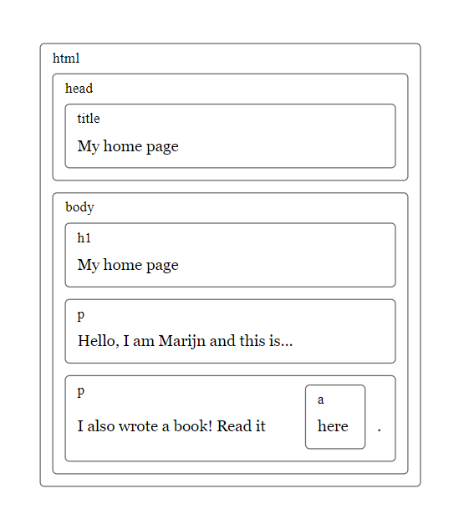
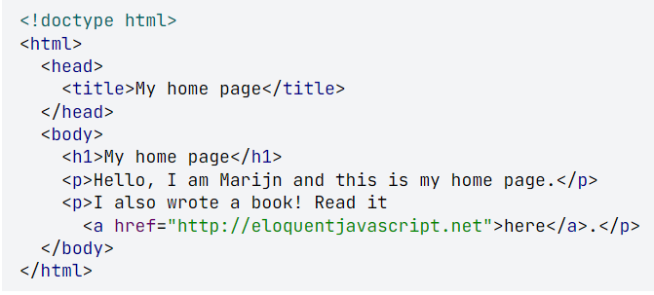
An HTML document is like a series of nested boxes. Tags such as <body> and </body> enclose other tags, which in turn contain other tags or text.

Slide 5
What is the Document Object Model (DOM)? (cont’d)
The data structure the browser uses to represent the HTML document follows this nested box shape
For each box, there is an object with which we can interact to find out things such as:
What HTML tag it represents
Which boxes and text it contains
This representation is called the Document Object Model, or DOM, for short
The global variable document gives us access to these objects
Its documentElement property refers to the object representing the HTML tag
It also provides the properties head and body, which hold the objects for those elements

Slide 6
Trees
A DOM is like a tree in that it is composed of many branches
Each element is referred to as a node
Each node may refer to other nodes, referred to as children, which in turn may have their own children
For a data structure to be a tree, it must have the following:
A branching structure
No cycles (a node may not contain itself, directly or indirectly)
A single, well-defined root (the root of the DOM is document.documentElement

Slide 7
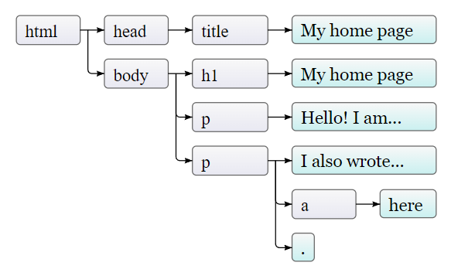
Trees (cont’d)
Nodes for regular elements, which represent HTML tags, determine the structure of the document
Those nodes can have child nodes. An example is document.body
Some child nodes can be leaf nodes containing pieces of text or HTML comments
In the picture, the leaves are text nodes, and the arrows indicate parent-child relationships between nodes

Slide 8
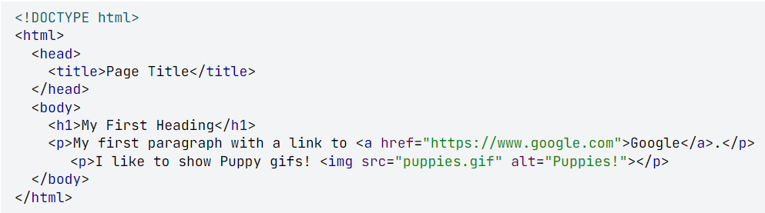
Quiz Time!!!
How many children does the body have?
How many root nodes are there?
Is DOCTYPE the root element?
Is the img element a node, given that it’s self closing?
Is the a node a child of anyone? If so, who?
How many total nodes are there in the tree?

Slide 9

DOM Construction Order
Once the HTML is parsed in the browser, the DOM gets constructed depth first from top to bottom
This means the browser starts at the top, then includes elements down and deeper into nested elements before going down
html
--head
----title
--body
----h1
----p (first one)
----p (second one)
------a

Slide 10
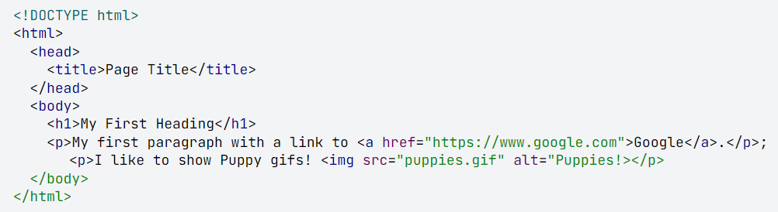
DOM Construction Order (cont)
In what order are these elements constructed?
html
--head
----title
--body
----h1
----p (first one)
------a
----p (second one)
------img

Slide 11
Why do we need to put the <script> tag at the end of the body?
The DOM gets constructed from the top down
If a <script> tag is in the <head> element, the script will most likely be loaded and run before the rest of the DOM is constructed
If that <script> tag refers to an element in the DOM, that element will not be there when the script is run

Slide 12
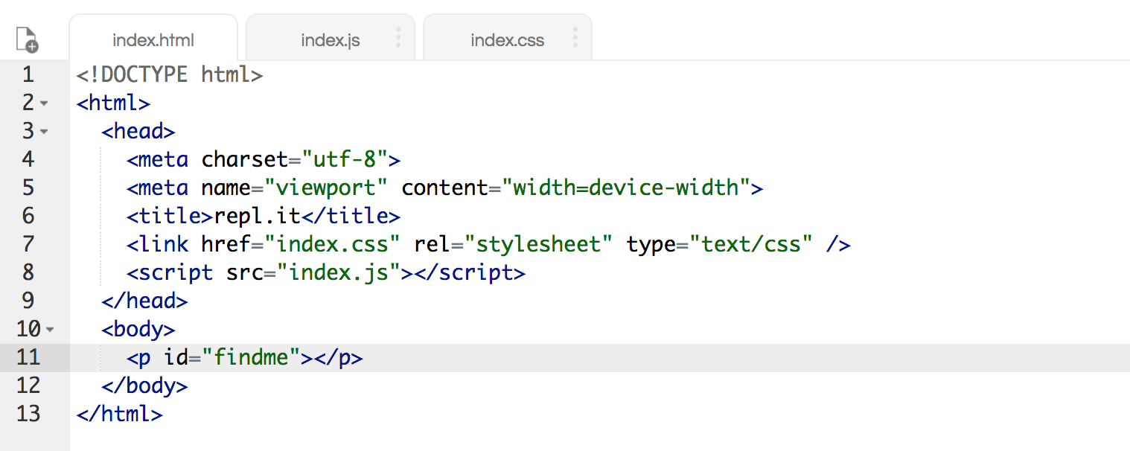
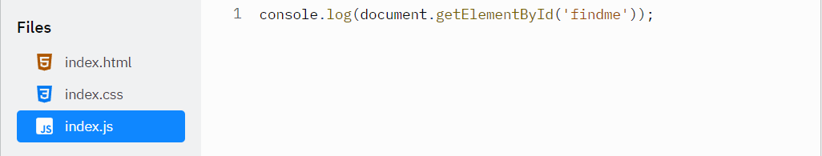
Let’s test it! First in the head…

Slide 13
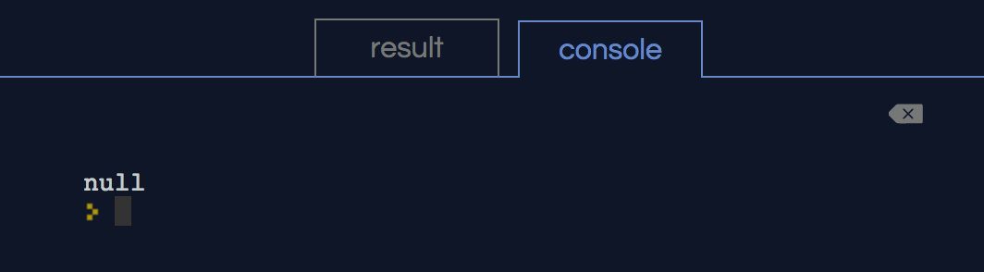
<script> tag in the head - result

Slide 14
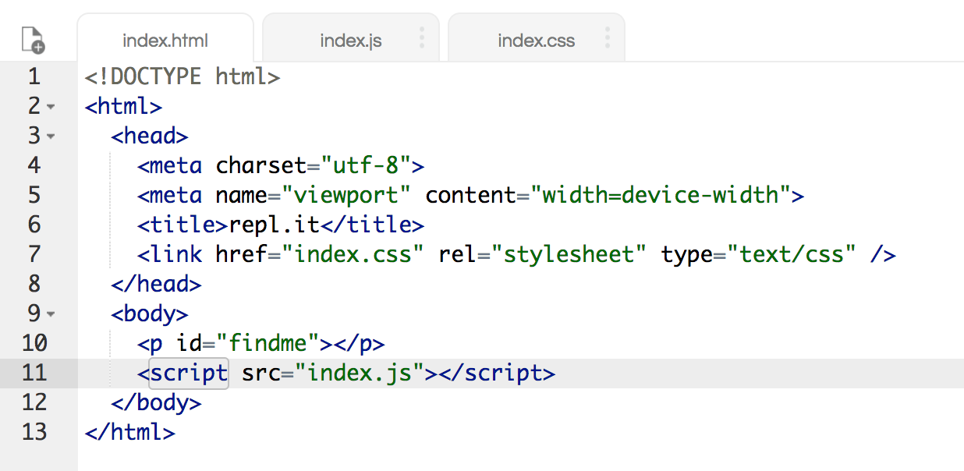
Now let’s place it at the bottom of the body…

Slide 15
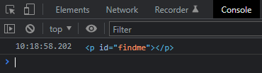
<script> tag at the bottom of the body - result

Slide 16
DOM – Finding elements
Trying to find a specific node in the document by starting at document.body and following a hard-coded path of links is a bad idea
Bakes assumptions into our program about the precise structure of the document – a structure we may want to change later
Another complicating factor – text nodes are created even for the whitespace between nodes

Slide 17
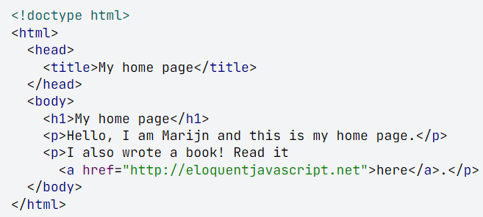
DOM – Finding elements (cont’d)
The <body> does not have just three children (the <h1> and two <p>) but actually has seven
- The <h1>, the two <p>, plus the spaces before, after and between them
- If we want to get the href attribute of the link, we don’t want to say, “get the second child of the sixth child of the document body.”
- better to say “get the first link in the document.” And we can.

Slide 18
Retrieving elements
All element nodes have a getElementsByTagName method
Collects all elements with the given tag name that are descendants of the give node
Returns them as an array-like object
To find a specific single node, give it an id attribute and use document.getElementById
A similar method, getElementsByClassName, searches through all the contents of an element node and retrieves all elements that have the given string in their class attribute

Slide 19
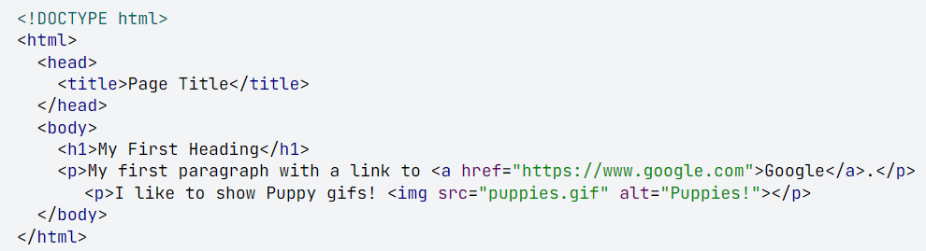
What is the simplest way to get the img element from the HTML below?

Slide 20
querySelector and querySelectorAll
querySelectorAll is defined on both the document object and on element nodes
It takes a selector string and returns an array-like object containing all the elements that it matches
Unlike methods such as getElementsByTagName, the object returned by querySelectorAll is not live
It wont change when you change the document
querySelector is similar, but it returns only the first matching element, or null if no elements match
Useful if you want a specific, single element

Slide 21
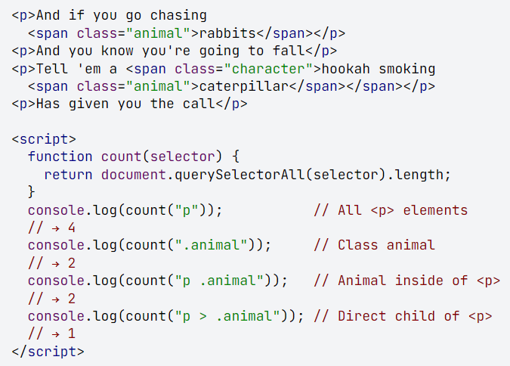
querySelectorAll - example

Slide 22
Attributes
Some element attributes, such as href, can be accessed through a property of the same name on the element’s DOM object
True for a limited set of commonly used standard attributes
BUT HTML allows you to set any attribute you want on nodes
This allows you to store extra information in a document
Made-up attributes will not be present as a property on the element’s node

Slide 23
getAttribute and setAttribute
The getAttribute and setAttribute methods can be used to work with made-up elements
It is recommended to prefix such made-up attributes with data- to ensure they do not conflict with any other attributes
The getAttribute method accepts a string and produces the value
The setAttribute method is used as follows:
element.setAttribute(attributeName, attributeValue)
To set the attribute “data-hello” equal to “world” in an element called myElement, you would write:
myElement.setAttribute(“data-hello”, “world”);

Slide 24
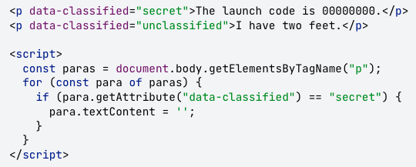
textContent
The textContent property can be used to get all the text in the node
Setting it to an empty string empties the contents of the node

Slide 25
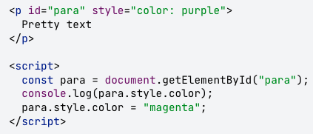
Updating styles
The style of an element can be directly manipulated via JavaScript through the node’s style property
This property holds an object that has properties for all possible style properties
The values of these properties are strings, which we can write to change a particular aspect of an element’s style

Slide 26
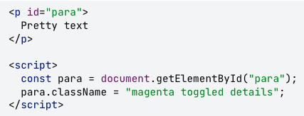
Updating styles (cont’d)
Some style properties contain dashes, such as font-family. When working with them in JavaScript, the dashes are removed and the property name uses camelCase (ex: fontFamily).
A better idea is to add and remove classes with the styles you want to update by using the className property on a DOM element
Remember class names are separated by spaces

Slide 27
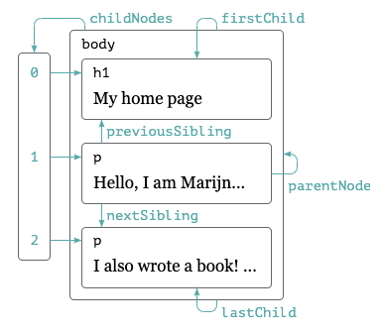
Moving through the tree
DOM nodes contain a wealth of links to other nearby nodes, as shown in the diagram
Every node has a parentNode property that points to its containing node
Every element node (node type 1) has a childNodes property that points to an array-like object holding its children

Slide 28
Moving through the tree (cont’d)
You can move anywhere in the tree using just parent and child links, but JavaScript also gives you access to a number of additional convenience links
The firstChild and lastChild properties point to the first and last child elements or have the value null for nodes without children
previousSibling and nexSibling point to adjacent nodes (nodes that have the same parent that appear immediately before or after the node itself)
For a first child, previousSibling will be null, and for a last child, nextSibling will be null

Slide 29
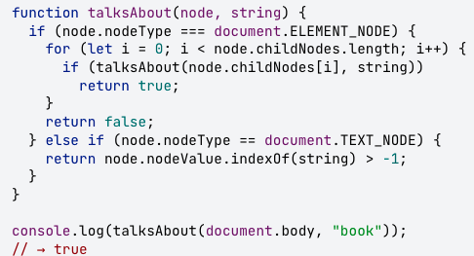
Moving through the tree (cont’d)
When dealing with a nested data structure, recursive functions are often useful. The following recursive function scans a document for text nodes containing a given string and returns true when it has found one.
The nodeValue property of a text node refers to the string of text that it represents

Slide 30
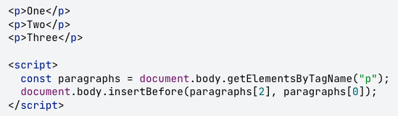
Changing the document
Almost everything about the DOM data structure can be changed
Element nodes have a number of methods that can be used to change their content
The removeChild method removes the given child node from the document
To add a child, we can use appendChild, which puts it at the end of the list of children, or insertBefore, which inserts the node given as the first argument before the node given as the second argument

Slide 31
Changing the document (cont’d)
A node can exist in the document in only one place
Inserting paragraph “Three” in front of paragraph “One” will first remove it from the end of the document and then insert it at the front, resulting in “Three/One/Two”
All operations that insert a node somewhere will, as a side effect, cause it to be removed from its current position (if it has one)
The replaceChild method is used to replace a child node with another one
It takes as arguments two nodes: the new node and the node to be replaced
The replaced node must be a child of the element the method is called on
Both replaceChild and insertBefore expect the new node as their first argument

Slide 32
Creating nodes
In the example on the following slide, we want to write a script that replaces all images (<img> tags) in the document with the text held in their alt attributes, which specifies an alternative textual representation of the image
This involves not only removing the images but adding a new text node to replace them. For this, we use the document.createTextNode method

Slide 33
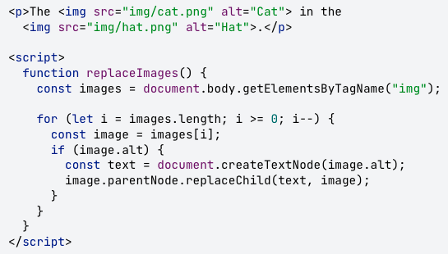
Creating nodes (cont’d)

Slide 34
Creating nodes (cont’d)
Given a string, createTextNode gives us a type 3 DOM node (a text node), which we can insert into the document to make it show up on the screen
The loop that goes over the images in the previous slide starts at the end of the list of nodes
This is necessary because the node list returned by a method like getElementsByTagName or a property like childNodes is live, meaning it is updated as the document changes
If we started from the front, removing the first image would cause the list to lose its first element so that the second time the loop repeats, wher I is 1, it would stop because the length of the collection is now also 1

Slide 35
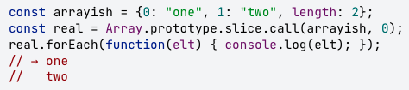
Creating nodes (cont’d)
If you want a solid collection of nodes, as opposed to a live one, you can convert the collection to a real array by calling the array slice method on it

Slide 36
Creating nodes (cont’d)
To create regular element nodes, you can use the document.createElement method
Takes a tag name and returns a new empty node of the given type
The example on the next slide defines a utility elt, which creates an element node and treats the rest of its arguments as children to that node
The function is then used to add a simple attribution to a quote

Slide 37
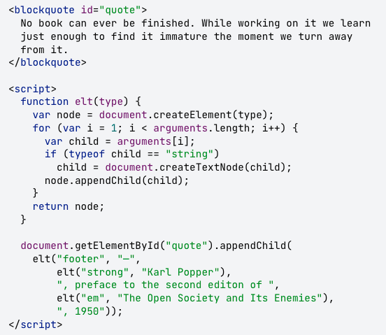
Creating nodes (cont’d)

Slide 38
Events in the DOM

Slide 39
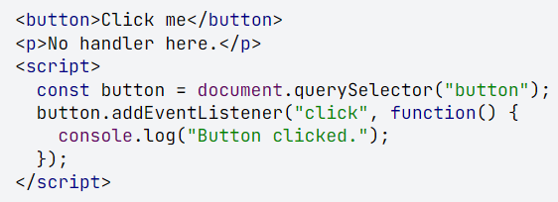
Adding and removing an event listener
Every DOM element has its own addEventListener method, which allows you to listen specifically on that element
In the following example, a handler is attached to the button node
Clicks on the button cause that handler to run, whereas clicks on the rest of the document do not

Slide 40
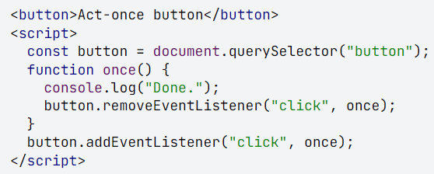
Adding and removing an event listener (cont’d)
The removeEventListener method, called with arguments similar to as addEventListener, removes a handler
To be able to unregister a handler function, we give it a name (such as “once”) so that we can pass it to both addEventListener and removeEventListener

Slide 41
Event objects
Event handler functions are passed an argument, called the event object, which gives us additional information about the event
For example, if we want to know which mouse button was pressed, we can look at an event object’s which property
The object’s type property always holds a string identifying the event (for example “click” or “mousedown”)
The information stored in an event object differs per type of event

Slide 42
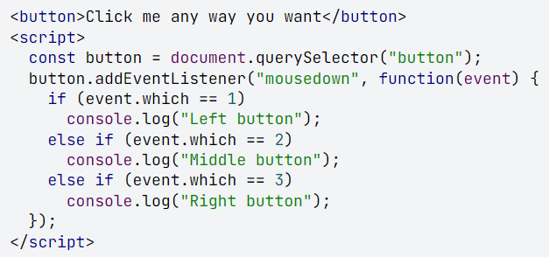
Event object (cont’d)

Slide 43
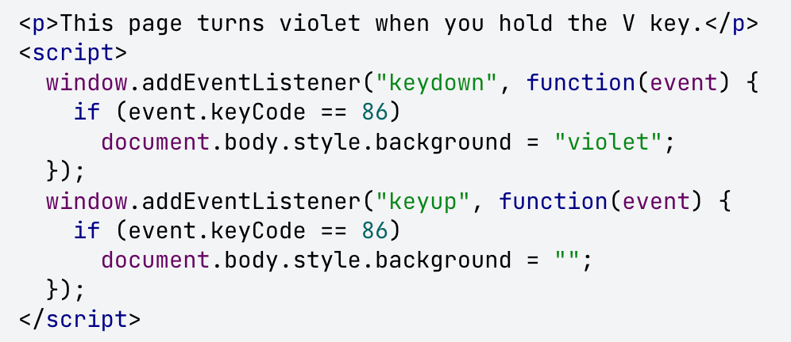
Key events
When a key on the keyboard is pressed, the browser fires a “keydown” event. When the key is released, a “keyup” event fires.

Slide 44
Key events (cont’d)
When a key is pressed and held, the “keydown” event fires again every time the key repeats
The code on the previous slide looked at the keycode property of the event object to identify which key is being pressed or released
It is not always obvious how to translate the numeric key code to an actual key
For letter and number keys, the associated key code will be the Unicode character code associated with the uppercase letter or number printed on the key
The code can be found using the charCodeAt() method

Slide 45
Key events (cont’d)
Some keys have unpredictable key codes
The best way to find the codes you need is usually to register a key event handler that logs the key codes it gets and press the key you are interested in
Modifier keys such as Shift, Ctrl, Alt, and Meta (Command on Mac) generate key events also
When looking for key combinations, you can also find out whether these keys are held down by looking at the shiftKey, ctrlKey, altKey and metaKey properties of keyboard and mouse events

Slide 46
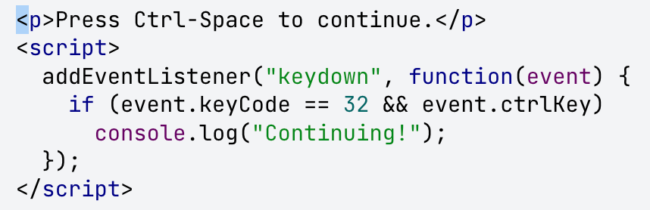
Key events (cont’d)

Slide 47
Key events (cont’d)
The “keydown” and “keyup” events give information about the physical key being pressed, but using key codes to get the actual text being typed is awkward
The “keypress” event fires right after “keydown” (and is repeated along with “keydown” when the key is held) but only for keys that produce character input
The charCode property in the event object contains a code that can be interprested as a Unicode character code
You can use the String.fromCharCode function to turn that code into an actual single-character string

Slide 48
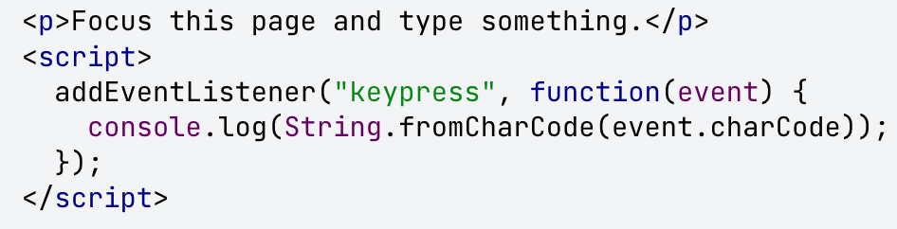
Key events (cont’d)

Slide 49
Key events (cont’d)
The DOM node where a key event originates depends on the element that has focus when the key is pressed
Normal nodes cannot have focus (unless you give them a tabIndex attribute) but things such as links, buttons, and form fields can
When nothing in particular has focus, document.body acts as the target node of key events

Slide 50
Mouse events
Pressing a mouse button also causes a number of events to fire
The ”mousedown” and “mouseup” events are similar to “keydown” and ”keyup” and fire when the button is pressed and released
This will happen on the DOM nodes that are immediately below the mouse pointer when the event occurs
After the “mouseup” event, a “click” event fires on the most specific node that contained both the press and the release of the button
If I press down the mouse button on one paragraph and then move the pointer to another paragraph and release the button, the “click” event will happen on the element that contains both those paragraphs
If two clicks happen close together, a “dblclick” (double-click) event also fires, after the second click event

Slide 51
Mouse events (cont’d)
To get precise information about the place here a mouse event happened, you can look at its pageX and pageY properties, which contain the event’s coordinates (in pixels) relative to the top-left corner of the document
The clientX and client properties are similar to pageX and pageY but relative to the part of the document that is currently scrolled into view

Slide 52
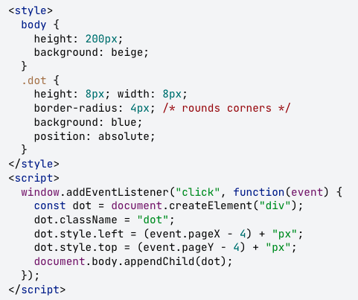
This implements a primitive drawing program
Every time you click the document, it adds a dot under your mouse pointer

Slide 53
Mouse motion
Every time the mouse pointer moves, a “mousemove” event fires, which can be used to track the position of the mouse
This is useful when implementing some form of mouse-dragging functionality
The following program displays a bar and sets up event handlers so that dragging to the left or right on this bar makes it narrower or wider

Slide 54
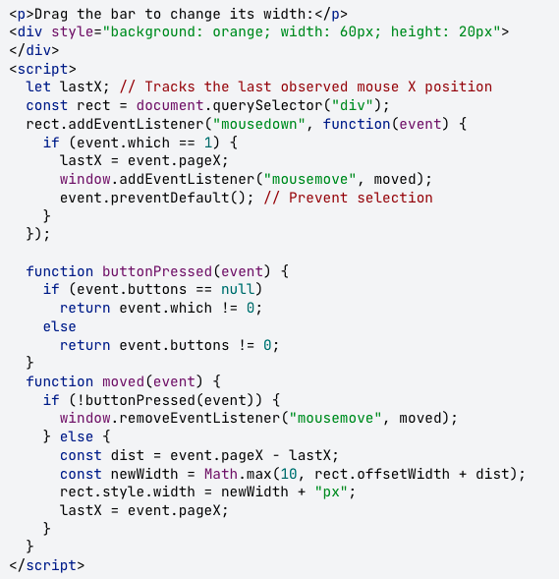
Mouse motion (cont’d)

Slide 55
Mouse motion (cont’d)
In the previous code, the “mousemove” handler is registered on the whole window
Even if the mouse goes outside of the bar during resizing, we still want to update its size and stop dragging when the mouse is released
We must stop resizing the bar when the mouse button is released
However, not all browsers give “mousemove” events a meaningful which property
There is a standard property called button, which provides similar information, but that is also not supported on all browsers
All major browsers support either buttons or which, so the buttonPressed function in the example first tries buttons, and falls back to which when that isn’t available

Slide 56
Mouse motion (cont’d)
Whenever the mouse pointer enters or leaves a node, a “mouseover” or ”mouseout” event fires
These two events can be used, among other things, for creating hover effects, showing or styling something whenever the mouse is over a given element
However, creating such an effect is not as simple as starting the effect on “mouseover” and ending it on “mouseout”

Slide 57
Events

Slide 58
What are events?
Events are actions or occurrences that happen in the system you are program, which the system tells you about so you can react to them
Ex: if a user clicks a button on a webpage, you might want to react to that action by displaying an information box
The system produces (“fires”) a signal of some kind when an event occurs and provides a mechanism by which an action can automatically be taken by running some code when the event occurs

Slide 62
JavaScript Class Setup
David Tarvin, AIM Code School

Slide 63
GitHub
VS Code
Google Classroom

